Slide 1
Sensors Technology
BECE409E
Module:1 Sensing Mechanism
Principles of Sensing: Resistive, Capacitive, Magnetic, Inductive, Piezoelectric, Piezo-resistance, Pyro-electric, Hall effect, RF sensing. Sensor materials and material properties. Sensor Technologies: Micro Technology, Micro-ElectroMechanical Systems Technology, Nanotechnology. Example of Smart Sensors in Nature (Vision, Hearing, Touch, and Smell).

Slide 2
Basics Concepts

Slide 3
Why we need Measurements?
The advancement of science and technology is dependent upon a parallel progress
in measurement techniques.
In order that the results are meaningful, there are two basic requirements:
The standard used for comparison purposes must be accurately defined.
The apparatus used and the method adopted must be proved.
There are two major functions in all branches of engineering:
Design of equipment and processes.
Proper operation and maintenance of equipment and processes.
Both of these functions require measurements.
Methods of Measurements:
Direct Method: The unknown quantity is directly compared against a standard.
Indirect Method: Measurement by direct methods are not always possible, feasible and practicable. These methods in most of the cases are inaccurate because of human factors. They are also less sensitive.

Slide 4
Instruments:
An instrument consists of a single unit which gives an output reading or signal
according to the unknown variable applied to it.
In more complex situations, a measuring instrument consists of several separate elements. These elements may consist of transducer elements which convert the measurand to an analogous form. The analogous signal is then processed by some intermediate means and then fed to the end devices to present the results for the purposes of display and or control.
These elements are:
A detector.
An intermediate transfer device.
An indicator.
Functions of Instruments:
Indicating function.
Recording function.
Controlling Function.

Slide 5
Classification of Instruments:
Absolute instruments: These instruments give the magnitude of the quantity under measurement in terms of physical constants of the instrument. Example: Galvanometer.
Secondary Instrument: These instruments are constructed that the quantity being measured can only be measured by observing the output indicated by the instrument.
Modes of Operation:
Analog Signal: signals that vary in a continuous fashion and take an infinite
number of values in any given range.
Digital signal: signals that vary in discrete steps and thus take only finite different
values in a given range.

Slide 6
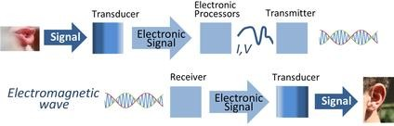
What is Transducer?
A device that receives a signal in the form of one type of energy and converts it to a signal in another form.
A device that changes one form of energy into another.
Example: Speaker
A speaker changes electrical energy from an amplifier into mechanical energy or sound waves. The electrical energy in the amp causes the speaker cone to move in and out creating air waves that our ears perceive as sound.
A microphone is the reverse of a speaker. It is a transducer that converts acoustic energy (in the form of sound waves from a human voice) and turns it into electrical energy (electrical impulses).

Slide 7
Sensors and Actuators:
What is a Sensor?
It is a transducer whose purpose is to sense or detect some characteristic of its
environs.
It is a transducer used to detect a parameter in one form and report it in another
form of energy.
Example: A pressure sensor detects pressure (a mechanical form of energy) and
converts it to electrical signal for display.
What is an Actuator?
An actuator is a transducer that accepts energy and produces the kinetic energy of
action.
The energy supplied to an actuator might be electrical or mechanical (Pneumatic, Hydraulic).
Example: Electrical motor and a Hydraulic cylinder are both actuators, converting electrical energy and fluid power into motion for different purposes.

Slide 8
Sensors and Actuators:
What is a Sensor?
It is a transducer whose purpose is to sense or detect some characteristic of its
environs.
It is a transducer used to detect a parameter in one form and report it in another
form of energy.
Example: A pressure sensor detects pressure (a mechanical form of energy) and
converts it to electrical signal for display.
What is an Actuator?
An actuator is a transducer that accepts energy and produces the kinetic energy of
action.
The energy supplied to an actuator might be electrical or mechanical (Pneumatic, Hydraulic).
Example: Electrical motor and a Hydraulic cylinder are both actuators, converting electrical energy and fluid power into motion for different purposes.

Slide 9
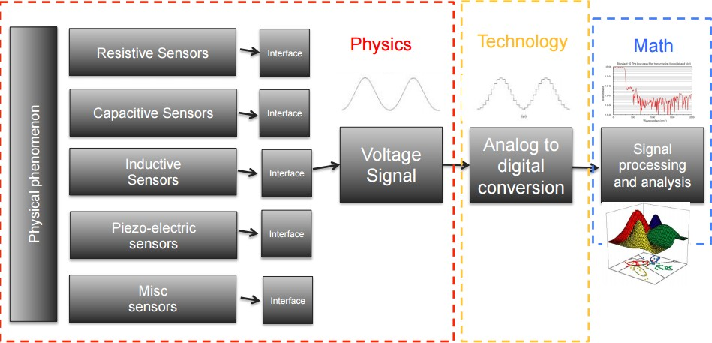

Slide 10
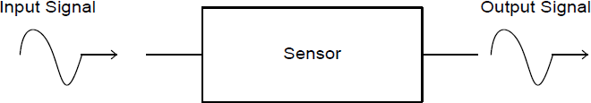
SENSORS
Definition:
A device for sensing a physical variable of a physical system or an environment
A device which provides a usable output in response to a specified
measurand ( American National Standards Institute)
A sensor acquires a physical quantity and converts it into a signal suitable for processing (e.g. optical, electrical, mechanical)
Nowadays common sensors convert measurement of physical
phenomena into an electrical signal
Active element of a sensor is called a transducer

Slide 11
Sensor Classification:
Different classification criteria may be selected.
All sensors may be of two kinds: passive and active.
Passive sensor: it does not need any additional energy source and directly generates an electric signal in response to an external stimulus. That is, the input stimulus energy is converted by the sensor into the output signal. Most of passive sensors are direct sensors as we defined them earlier.
Example: a thermocouple, a photodiode, and a piezoelectric sensor.
Active Sensor: it requires external power for its operation, which is called an excitation signal. That signal is modified by the sensor to produce the output signal. Example: a thermistor is a temperature sensitive resistor. It does not generate any electric signal, but by passing an electric current through it (excitation signal) its resistance can be measured by detecting variations in current and/or voltage across the thermistor.

Slide 12
Transducer?
A device which converts one form of energy to another
When input is a physical quantity and output electrical → Sensor When input is electrical and output a physical quantity → Actuator
e.g. Piezoelectric:
Force -> voltage
Voltage-> Force
Sensors
Actuators
Physical parameter
Electrical Output
Electrical Input
Physical Output
Microphone, Loud Speaker

Slide 13
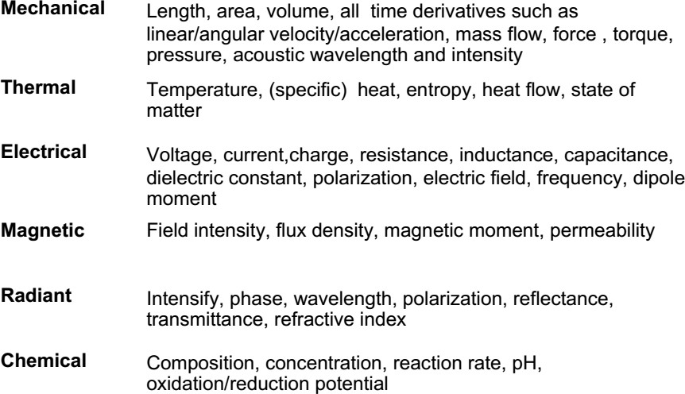
Signal domains with examples

Slide 14
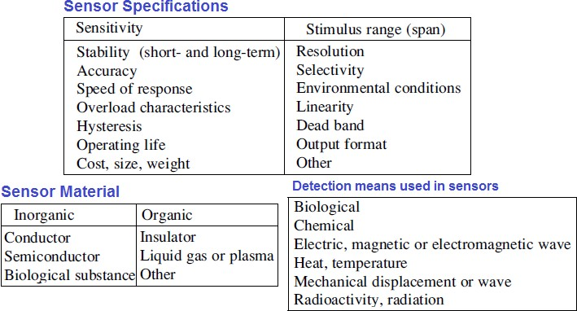
Sensor Classification:
Sensors can be classified depending some of its properties that may be of a specific interest.

Slide 15
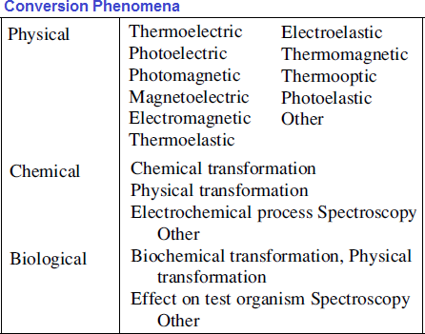
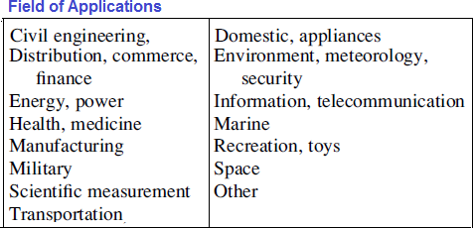
Sensor Classification:

Slide 16
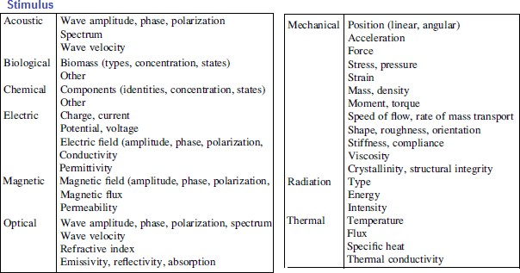
Sensor Classification:

Slide 17
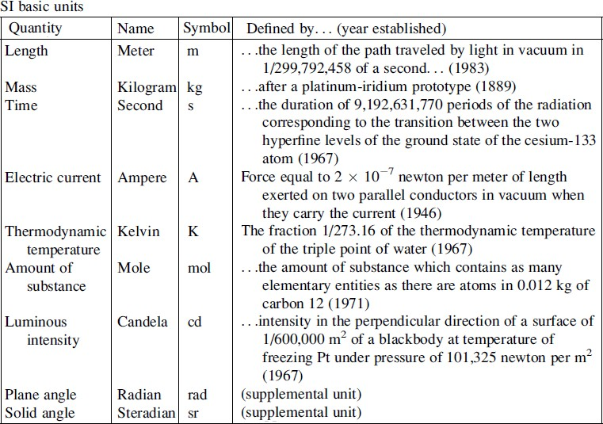
Units of Measurements:
The base measurement system is known as SI, which stands for Le Syste´me International d’Unite´s in French:

Slide 18
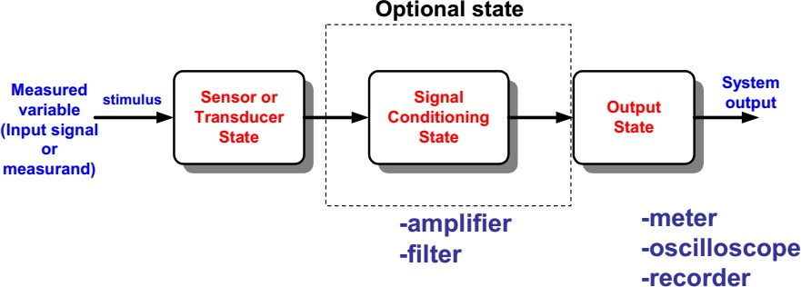
Functional Block of a Measurement System
Sensor or transducer is an input device convert the quantity under measurement into a detectable signal form: electrical, mechanical, optical etc.
Signal conditioning modifies the transducer signal into a desired
form
e.g. amplification, noise reduction.
Output State provides an indication of the value of the measurement (readout device or recording)

Slide 19
Physical Principles: Examples
Amperes’s Law
A current carrying conductor in a magnetic field experiences a force (e.g. galvanometer)
Curie-Weiss Law
There is a transition temperature at which ferromagnetic materials exhibit paramagnetic behavior
Faraday’s Law of Induction
A coil resist a change in magnetic field by generating an opposing voltage/current (e.g. transformer)
Photoconductive Effect
When light strikes certain semiconductor materials, the resistance of the material decreases (e.g. photoresistor)

Slide 20

The performance characteristics may be broadly divided into two groups, namely ‘STATIC’ and ‘DYNAMIC’ characteristics.
Static characteristics
The performance criteria for the measurement of quantities that remain constant, or vary quite slowly.
Dynamic characteristics
The relationship between the system input and output when the measured quantity (measurand) is varying rapidly.
10

Slide 21


Slide 22

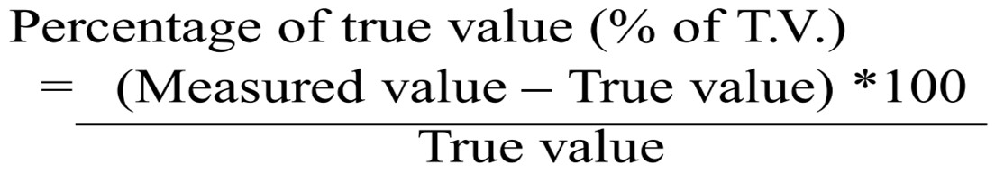
Definition: “Average of infinite values taken when the average deviation due to various contributing factors approach zero”.
It is the exact value or perfectly correct value in any measuring instrument.
This value is not obtainable, because positive deviations from the true value are not equal to the negative deviations (or) vice versa and hence do not cancel each other.

Slide 23

Measured value => Actual value measured using an instrument
True value => Perfect reading or Theoretical value
Static error = Measured value – True value
Error may be positive or negative
Study of error helps in reducing them to get more reliable results.

Slide 24

It is the complement of static error
Static correction = True value – Measured value
= - Static error
When there is an error of – 5%, the correction required is +5%

Slide 25
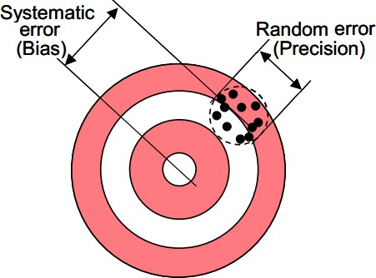
Systematic errors: Result from a variety of factors
Interfering or modifying variables (i.e., temperature)
Drift (i.e., changes in chemical structure or mechanical stresses)
The measurement process changes the measurand (i.e., loading errors)
The transmission process changes the signal (i.e., attenuation)
Human observers (i.e., parallax errors)
Systematic errors can be corrected with compensation methods (i.e., feedback, filtering)
Random errors (NOISE):
A signal that carries no information.
Sources of randomness:
Repeatability of the measurand itself (i.e., height
of a rough surface)
Environmental noise (i.e., background noise
picked by a microphone)
Transmission noise (i.e., 60Hz hum)
Signal to noise ratio (SNR) should be >>1

Slide 26

This is the closeness with which the measuring instrument can measure the ‘true value’ of the measurand under stated conditions of use.
Accuracy means approaching (or) conforming truth.
The accuracy of an instrument is quantified by the difference of its readings and the one given by the ultimate or primary standard.

Slide 27

“It is the degree of agreement among group of readings”
(or)
“It is the ability of the instrument to give consistent reading”
Precision is often confused with accuracy.
High precision does not imply anything about measurement accuracy.

Slide 28
Resolution (Discrimination):
It is the minimal change of the input necessary to produce a detectable change at the output.
When the increment is from zero, it is called Threshold.
Two terms closely related to precision Repeatability and Reproducibility. Repeatability: is the precision of a set of measurements taken over a short time interval Reproducibility: is the precision of a set of measurements BUT:
taken over a long time interval or
Performed by different operators or
with different instruments or
in different laboratories

Slide 29
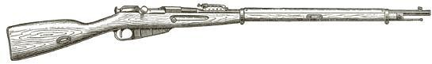
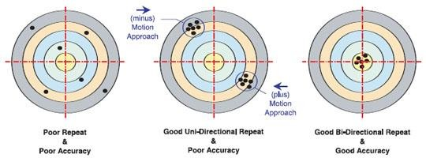
System Calibration

Slide 30

Dead Time: “The time required by a measurement system to begin to respond to a change in the measurand”.
Dead Zone: “It is the largest change of input quantity for which there is no output of the instrument”.
It is caused by friction, backlash or hysteresis.

Slide 31

Instrument
Reading
Measured Quantity
Measurand
Dead time
Time

Slide 32

0.7 V
Current
Output
Voltage
Dead Zone
Input
Example: Forward characteristics of a PN Junction diode

Slide 33

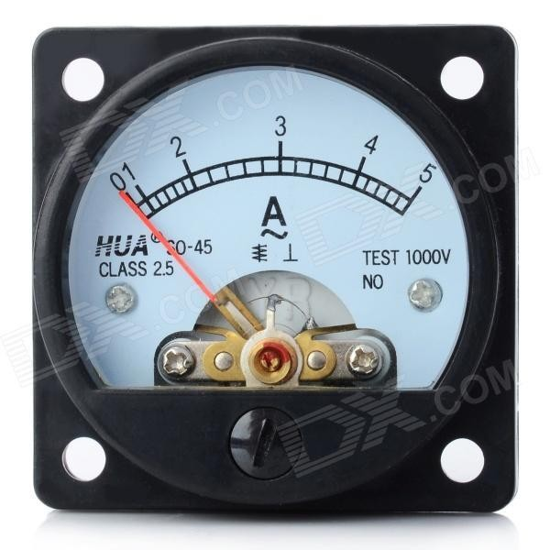
“The region between the
limits within which a
quantity is measured, received, or transmitted, expressed by stating the lower and upper range values”.
It is input dependent

Slide 34

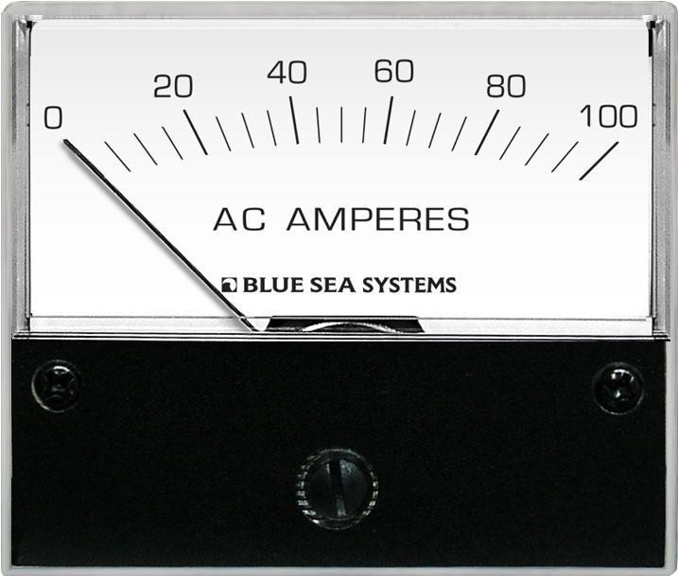
“The algebraic difference between the upper and lower range-values”.
It is Instrument dependent.

Slide 35
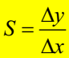
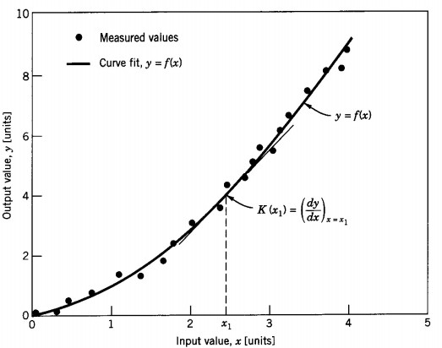
Sensitivity
The sensitivity of measurement is a measure of the change in instrument output that occurs when the quantity being measured changes by a given amount

Slide 36
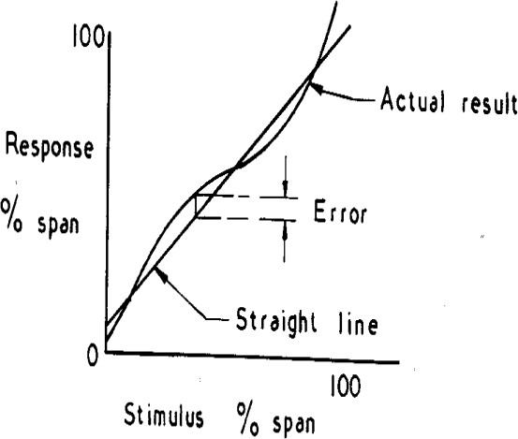
Linearity
This is the closeness to a straight line of the relationship
between the true process variable and the measurement.
i.e. deviation of transducer output curve from a
specified straight line.

Slide 37

Deal with (or) indicate the performance of the instrument when it is subjected to a time varying input.
When subjected to dynamic input, e.g. sinusoidal, an instrument has a response with differences in both amplitude and phase (time lag) from the input.

Slide 38

Definition:
“The difference between the true value of measuring quantity changing with time and the value indicated by the measuring system, assuming the static error to be zero”.

Slide 39

Definition: “The rapidity with which an instrument responds to change in the value of quantity being measured”.

Slide 40

Definition: “The retardation (or) delay in the response of the instrument to a change in the input signal”.
Retardation Type:
Response of an instrument begins immediately after a change in measured quantity has occurred.
Time Delay Type:
Response of the instrument begins after a dead time, after application of the input. It is very small, in order of fraction of seconds.
It causes dynamic error.

Slide 41

Definition:
“The degree of closeness with which the system indicates the changes in the measured quantity without any dynamic error”.
Ability of system to produce output in the same form as input.

Slide 42
Transducers and its Classifications

Slide 43
A device which converts a physical quantity into a another physical quantity is called a transducer.
A device which converts a physical quantity into the proportional electrical signal is called a electrical transducer.

Slide 44
Classifications
There are of many different types of transducer, they can be classified based on various criteria.

Slide 45
Based on the physical phenomenon
Primary Transducer
Secondary Transducer

Slide 46
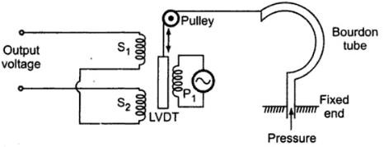
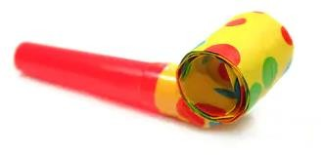
Based on the physical phenomenon
Primary Transducer and Secondary Transducer
Ø Some transducers consist of mechanical device along with the electrical device.
Ø In such transducers mechanical device acts as a primary transducer and converts physical quantity into mechanical signal.
Ø The electrical device then converts mechanical signal produced by primary transducer into an electrical signal.
Ø Therefore, electrical device acts as a secondary transducer.
Ø For an example, in pressure measurement Bourdons tube acts as a primary transducer which converts a pressure into displacement and LVDT acts as a secondary transducer which converts this displacement into an equivalent electrical signal.

Slide 47
Based on the power type Classification
Active transducer
Passive transducer

Slide 48
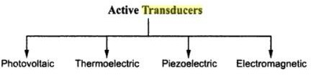
Active Transducers
Ø Active transducers are self-generating type of transducers.
Ø These transducers develop an electrical parameter (i.e. voltage or current) which is proportional to the quantity under measurement.
Ø These transducers do not require any external source or power for their operation.
Ø They can be subdivided into the following commonly used types

Slide 49
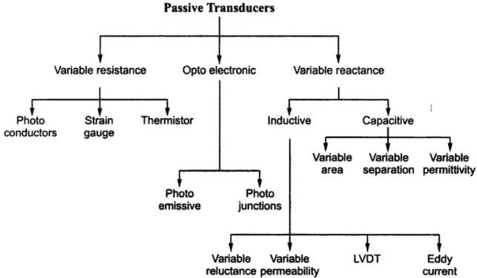
Passive Transducers
Ø Passive transducers do not generate any electrical signal by themselves.
Ø To obtain an electrical signal from such transducers, an external source of power is essential.
Ø Passive transducers depend upon the change in an electrical parameter (R, L, or C). Ø They are also known as externally power driven transducers.
Ø They can be subdivided into the following commonly used types

Slide 50
Based on the type of output the classification of transducers are made
Analog transducer
Digital transducer

Slide 51
The transducers can be classified on the basis of the output which may be a continuous function of time or the output may be in discrete steps.
Analog Transducers
Ø These transducers convert the input quantity into an analog output which is a continuous function of time.
Ø A strain gauge, LVDT, thermocouples or thermistors are called analog transducers as they produce an output which is a continuous function of time.
Digital Transducers
Ø Digital transducers produce an electrical output in the form of pulses which forms an unique code.
Ø Unique code is generated for each discrete value sensed.
Examples : Shaft Encoders , Digital Tachometers , Limit Switches etc

Slide 52
Based on the transduction phenomenon
Transducer
Inverse transducer
When you change energy from any form to other form(generally
electrical) you consider it as a transducer.
When you go the other way round, it's inverse transducer.
Example: Piezoelectric crystal when deformed causes charge distribution within itself to produce a potential difference, hence electrical energy.
Applications: Electric Drum sets and Electric Guitar.

Slide 53
Based on the electrical phenomenon is a best Classification of Transducer
Resistive transducer
Capacitive transducer
Inductive transducer
Photoelectric transducer
Photovoltaic transducer

Slide 54
Resistive transducer
The transducer whose resistance varies because of the environmental effects such type of transducer is known as the resistive transducer. The change in resistance is measured by the ac or dc measuring devices. The resistive transducer is used for measuring the physical quantities like temperature, displacement, vibration etc.
The resistive transducer converts the physical quantities into variable resistance which is easily measured by the meters. The process of variation in resistance is widely used in the industrial applications.

Slide 55
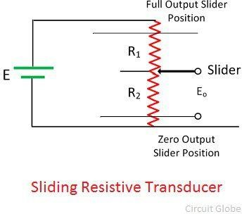
Example – The circuit of the sliding resistive transducer is shown in the figure below. The sliding contacts are placed on the resistive element. The slider moves horizontally. The movement of the slider changes the value of the resistive element of the transducer which is measured by the voltage source E.
The displacement of the slider is converted into an electrical signal.

Slide 56
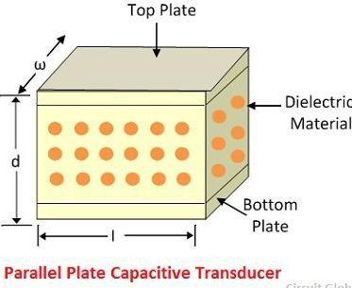
Capacitive transducer
The capacitive transducer is used for measuring the displacement, pressure and other physical quantities. It is a passive transducer that means it requires external power for operation. The capacitive transducer works on the principle of variable capacitances. The capacitance of the capacitive transducer changes because of many reasons like overlapping of plates, change in distance between the plates and dielectric constant.
The capacitive transducer contains two parallel metal plates. These plates are separated by the dielectric medium which is either air, material, gas or liquid. In the normal capacitor the distance between the plates are fixed, but in capacitive transducer the distance between them are varied.
The capacitive transducer uses the electrical quantity of capacitance for converting the mechanical movement into an electrical signal.

Slide 57
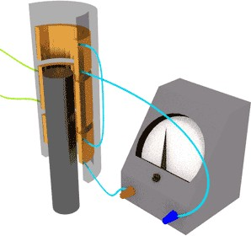
Inductive transducer
Inductive transducers work on the principle of inductance change due to any appreciable change in the quantity to be measured i.e. measured.
For example, LVDT, a kind of inductive transducers, measures displacement in terms of voltage difference between its two secondary voltages. Secondary voltages are nothing but the result of induction due to the flux change in the secondary coil with the displacement of the iron bar.

Slide 58
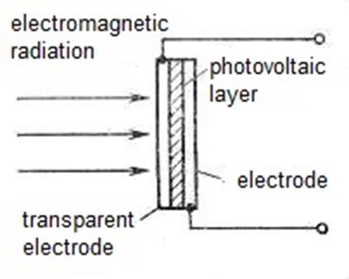
Photovoltaic transducer
A photovoltaic transducer is simply another name for a solar panel.
A transducer changes one energy to another in this case light energy to electrical energy.
The two most common type of photovoltaic transducers are silicon and selenium based.

Slide 59
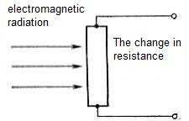
Photoelectric transducer
Photo-electric transducer are such primary measuring transducers, which react on an electromagnetic radiation, falling on the surface of transforming element. A radiation can be visible, i.e. light, and also to have a large or less wave-length and be invisible.

Slide 60
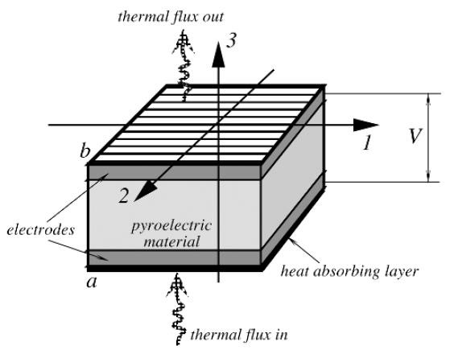
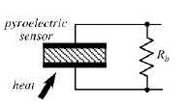
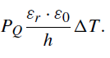
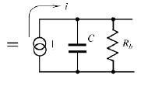
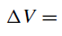
Pyroelectric Sensors
Pyroelectric Sensors are made of pyroelectric materials which are crystalline substances capable of generating an electrical charge in response to heat flow.
Like piezoelectrics, the pyroelectric materials are used in the form of thin slices or films with electrodes deposited on the opposite sides to collect the thermally induced charges (see figure). The pyroelectric sensor is essentially a capacitor which can be electrically charged by an influx of heat. The detector does not require any external electrical bias (excitation signal). It needs only an appropriate electronic interface
The pyroelectric sensor has two electrodes on the opposite sides of the crystal. Thermal radiation is applied along axis 3 from the bottom and escapes upward.
Pyroelectric sensor and its equivalent circuit.

Slide 61
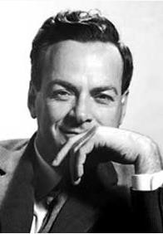

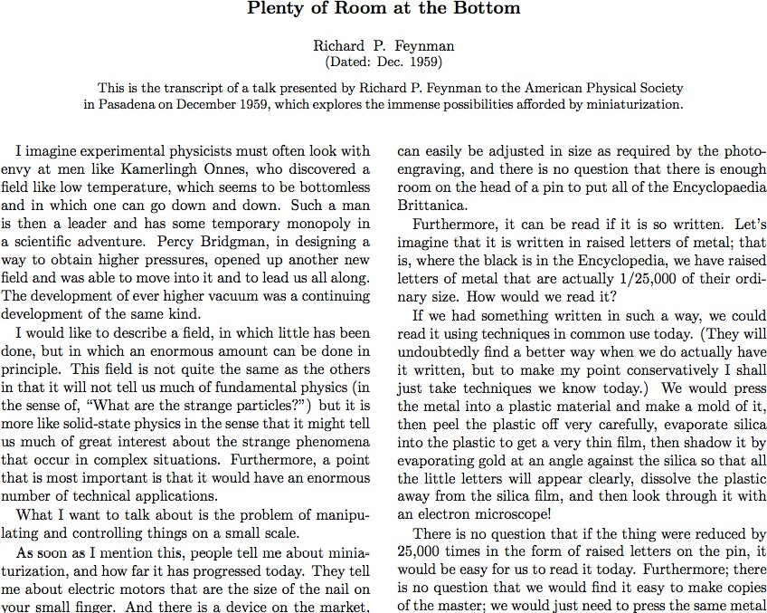
Origin of NanoScience and Nanotechnology
Richard Feynman
Ref: http://www.pa.msu.edu/~yang/RFeynman_plentySpace.pdf

Slide 62
Is Nanotechnology new????

Slide 63
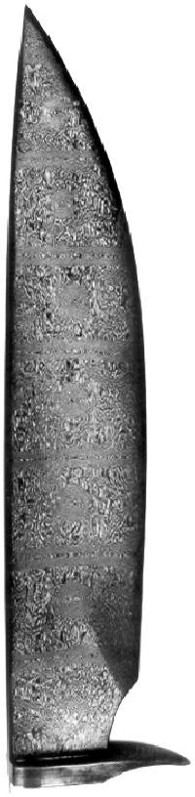
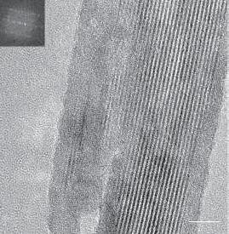
Strong
Sharp
Flexible
HRTEM Image Of Carbon Nanotubes In A Genuine Damascus Sabre
M. Reibold et al., Nature 2006
Damascus Sword (11th century)

Slide 64
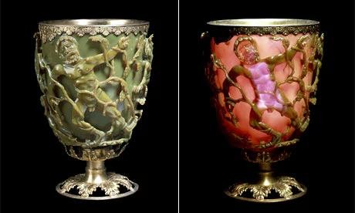
The stunning Lycurgus cup(AD 400)
Reveals a brilliant red when light passes through its sections of glass containing gold-silver alloyed nanoparticles

Slide 65
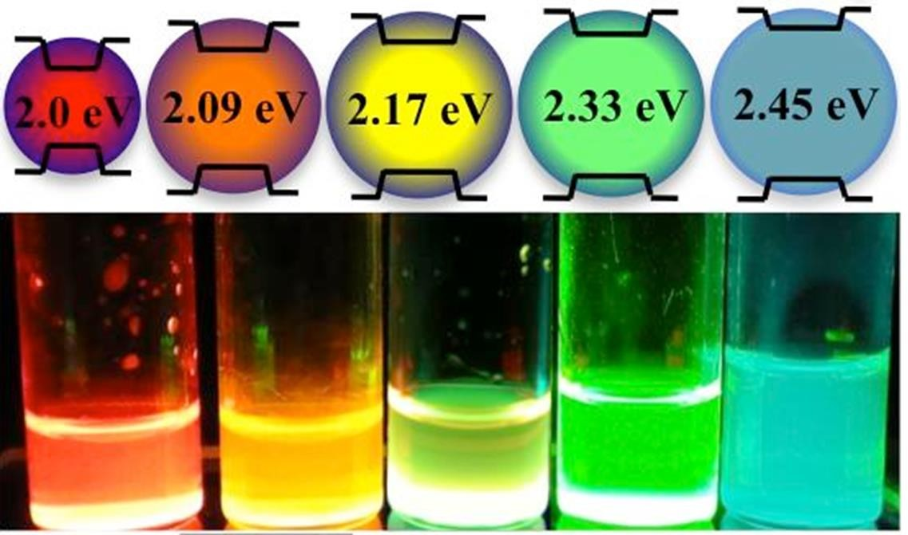
A bulk material should have constant physical properties regardless
of its size, but at the nano-scale size-dependent properties are often
observed.
5

Slide 66
How about Nature?

Slide 67

Close-up of water droplets on a lotus leaf

Slide 68
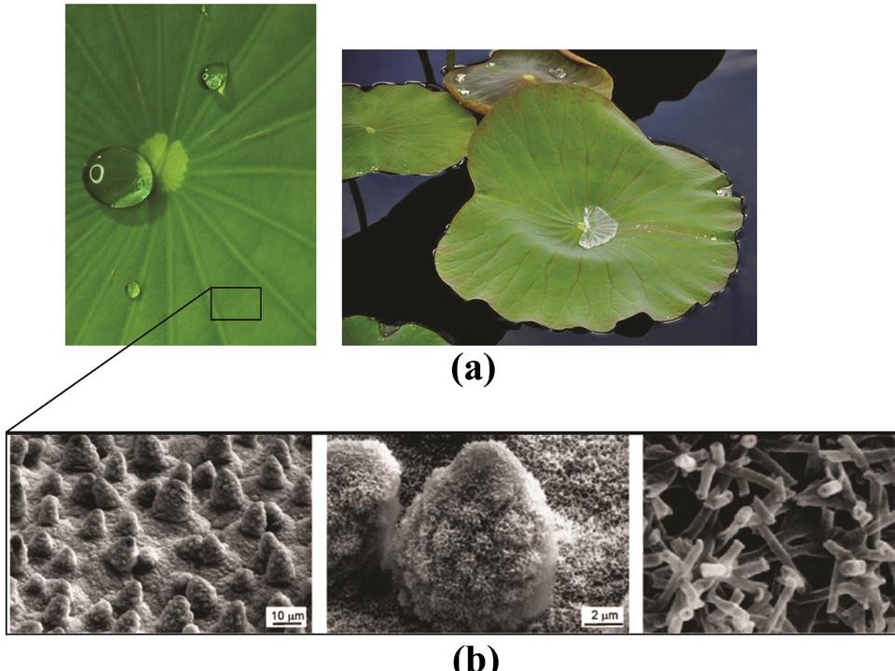
Raja Sellappan
8

Slide 69
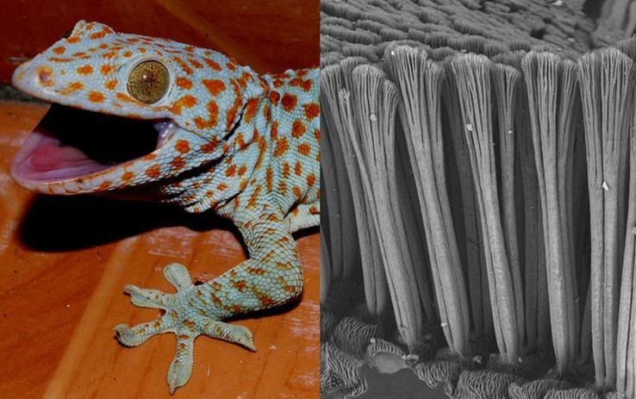

hang its whole weight from a single toe, even on a sheer piece of glass.
9

Slide 70
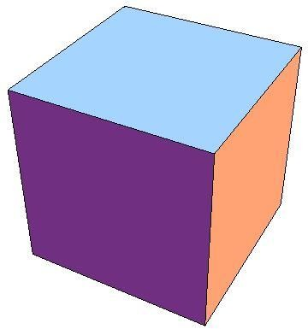


What is Nano?
The study, design, creation, synthesis, manipulation, and application of functional materials, devices and systems through control of matter and energy at the nanometer scale.
bulk
1~100nm
atom
10

Slide 71
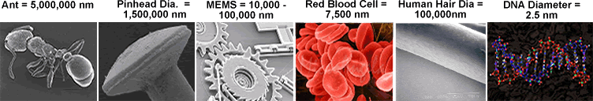
What is Nano?
Our fingernails grow at the rate of 1 nm per second.
The head of a pin is about 1 million nanometres across.
A human hair is about 100,000 nm in diameter.
A DNA molecule is about 1-2 nm wide.
MEMS: Microelectromechanical systems
11

Slide 72
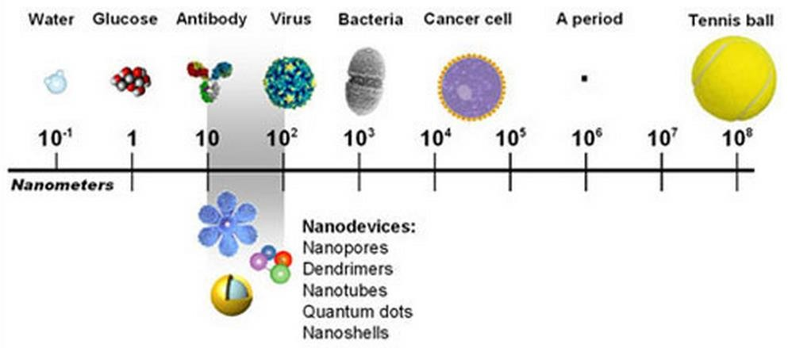
What is Nano?
Nano = 10⁻⁹ meter (1 billonth of meter)
Size of an atom= 0.1 nm = Ångstrom
Raja Sellappan

Slide 73
Nanosized particles exhibit different properties than large particles of the same substance!

Slide 74

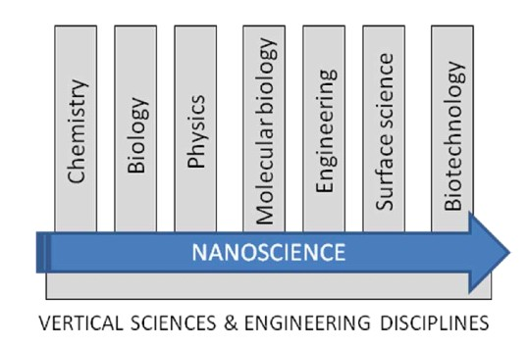
Nanoscience and Nanotechnology
Nanoscience:

Slide 75
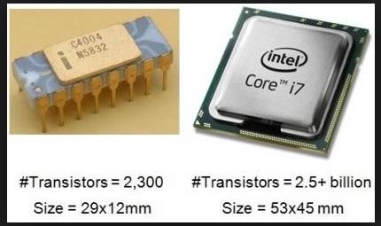



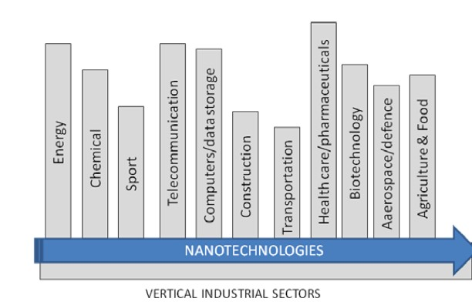
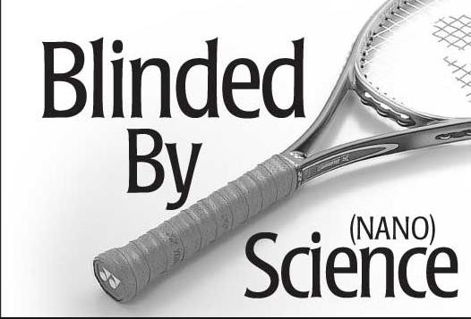
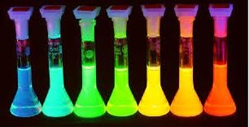
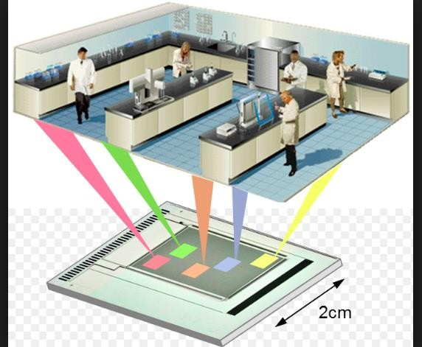


Slide 76




Nanoelectronics
CPU: Central Processing Unit
CPU is the heart of the computer which determines its performance (Higher the transistors in CPU better the performance)
50 years back
Intel’s 4004 CPU (10 micron or
10,000 nm)
2300 transistors
2013
Intel’s Ivy Bridge CPU (22 nm)
Billions of transistors
Advantages of nanoelectronics
Miniaturization of devices (compactness).
Low power consumption and less materials consumption.
Faster device response (computing performance).

Slide 77

Nanoelectronics
Single electron transistor (SET)

Slide 78





Nanophotonics
study of the behavior of light on the nanometer scale, and of the interaction
of nanometer-scale objects with light.
Optoelectronics and micro/nanoelectronics Solar cells
Spectroscopy Microscopy
Lycurgus cup
>1700 years old
Church Window
Gold and Silver colloidal nanoparticles
Semiconductor quantum dots

Slide 79




Optical Nanoantenna
Gold nanoparticles antenna
Yagi-Uda antenna
SEM image of nanoantenna

Slide 80

Magnetic (Targeted) Drug Delivery

Slide 81


Imaging
Molecular imaging of cells and tissues
Tumor identifying in mouse
Label-free method

Slide 82

Nanosensors

Slide 83

Carbon nanomaterials
Nobel Prize in chemistry (1996): Fullerene Nobel Prize in Physics (2010): Graphene
Raja Sellappan

Slide 84
Change in material properties at Nano scale

Slide 85

Introduction
When atoms come into close proximity with other atoms in a solid, most of the electrons remain localized and may be considered to remain associated with a particular atom.
However, some outer electrons will become involved in bonding with neighbouring atoms. Upon bonding the atomic energy level diagram is modified. Briefly, the well defined outer electron states of the atom overlap with those on neighbouring atoms and become broadened into energy bands.

Slide 86























What makes nano so much different from micro?
Quantum phenomena brought about by reduction in dimensionality induce new physical and chemical properties. (Quantum Confinement )
Increased Surface to Volume Ratio (S/V) – Surface area

Slide 87






Surface to Volume Ratio
Smaller the Better?

Slide 88

Introduction
Surface to Volume Ratio

Slide 89

Surface Area
The total surface area (or) the number of surface atom increases with reducing size of the particles

Slide 90


Slide 91


Slide 92
Nano Material
1. Nano Materials could be defined as the materials with at least one of its dimensions in the range of a Nano meter.
Materials that are Nano scale in one dimension are layers, such as a Thin films or Surface coatings.
Materials that are Nano Scale in two dimensions include Nano wires and Nano tubes.
Materials that are Nano scale in three dimensions are particles for example precipitates, colloids and quantum dots (Small particles of Semiconductor Materials)

Slide 93





TYPES OF NANOSTRUCTURES
µm
BULK (Three Dimensional) Degree of freedom = 3 Degree of confinement = 0
µm
2-Dimensional Nanomaterial (Quantum wells, Thin Films) Degree of freedom = 2
Degree of confinement = 1
µm
nm
µm
nm
nm
1-Dimensional Nanomaterial (Nanowires & Nanorods) Degree of freedom = 1
Degree of confinement = 2
0-Dimensional Nanomaterial (Nanoparticles)
Degree of freedom = 0 Degree of confinement = 3

Slide 94
Why properties of Nano Materials are different ?
The properties of Nano Materials are very much different from those at a larger scale.
Two principal factors cause the properties of Nano Materials to differ significantly from other materials.
Increased relative surface area (High surface to Volume ratio).
Quantum confinement effect.
These factors can charge or enhance properties such as reactivity , strength and electrical characteristics.

Slide 95
Increase in Surface Area to Volume ratio
Nano Materials have a relatively larger Surface area when compared to the same volume or mass of the material produced in a larger form.
Let us consider a Sphere of radius “r”. Its Surface Area =4πr^{2.}
Its volume= 4/3πr³
Surface Area to Volume Ratio= 3/r.
Thus when the radius of the Sphere decreases , its Surface to Volume ratio increases.

Slide 96
Quantum Confinement
In Nano Crystals, the Electronic energy levels are not continuous as in the bulk but are discrete (finite density of states), because of the confinement of the electronic Wave function to the physical dimensions of the particles. This phenomenon is called Quantum confinement.
Quantum confinement can be observed once the diameter of a material is of the same magnitude as the de Broglie wavelength of the electron wave function. When materials are this small, their electronic and optical properties deviate substantially from those of bulk materials.

Slide 97

Thermal Properties
The large increase in surface energy and the change in interatomic spacing as a function of nanoparticle size have a marked effect on material properties.
The melting point of gold particles, which is really a bulk thermodynamic characteristic, has been observed to decrease rapidly for particle sizes less than 10 nm.

Slide 98
Mechanical Properties
Planar defects, such as dislocations, in the crystalline structure of a solid are extremely important in determining the mechanical properties of a material.
Many mechanical properties, such as toughness, are highly dependent on
the ease of formation or the presence of defects within a material.
As the system size decreases, the ability to support such defects becomes increasingly more difficult and mechanical properties will be altered accordingly.
The reduction in the elastic strain energy of dislocations in nanocrystals has also got some important consequences. The forces on dislocations due to externally applied stresses are reduced by a factor of about three and the interactive forces between dislocations are reduced by a factor of about 10.
For example, single- and multi-walled carbon nanotubes show high mechanical strengths and high elastic limits that lead to considerable mechanical flexibility and reversible deformation

Slide 99


Mechanical Properties Nanocrystalline materials
For stabilised zirconia, the hardness has been proved to be 3 times higher for nanograined components compared to micron sized grains.

Slide 100

Structural Properties
The increase in surface area and surface free energy with decreasing particle
size leads to changes in interatomic spacings.
Semiconductors and metal oxides there is evidence that interatomic spacings increase with decreasing particle size

Slide 101
Chemical Properties
The Electronic structure of Nanoparticles is dependent on its size and the ability of Nano cluster to react, depends on cluster size.
Due to large Surface area to volume ratio the variations in geometry and the electronic structure of Nano particles have a strong effect on catalytic properties.
The ionization potential (the energy required to remove an electron) is generally higher for small atomic clusters than for the corresponding bulk material.

Slide 102
Electronics Properties
The electronic structure of Nano materials is different from its bulk material. The density of the energy states in the conduction band changes.
For semiconductors such as ZnO, CdS, and Si, the bandgap changes with size
-When the bandgaps lie in the visible spectrum, changing bandgap with size means a change in color
Nano clusters of different sizes will have different electronic structures and different energy level separations.
Discrete nature of energy states
In certain cases, conducting materials become insulators below a critical length scale, as the energy bands cease to overlap.
Ballisitic transport rather than diffusive as in bulk

Slide 103

Band gap
The band gap increases with reducing the size of the particles

Slide 104
Magnetic Properties
The large surface area to volume ratio results in a substantial proportion of atoms (those at the surface which have a different local environment) having a different magnetic coupling with neighbouring atoms, leading to differing magnetic properties.
The Magnetic Moment of Nano particles is found to be very less when
compared them with its bulk size.
Bulk ferromagnetic materials usually form multiple magnetic domains, small magnetic nanoparticles often consist of only one domain and exhibit a phenomenon known as superparamagnetism due to the huge surface energy.
superparamagnetism is a form of magnetism, which appears in sufficiently small nanoparticles, magnetization can randomly flip direction under the influence of temperature.
General Applications:
Ferrofluid: tunable viscosity
Biomedical applications
Imaging: Contrast agents in Magnetic Resonance Imaging (MRI)
Magnetic separation: cell-, DNA-, protein- separation, RNA fishing
Treatments: targeted drug delivery, magnetic hyperthermia, magnetofection

Slide 105

Magnetic Properties

Slide 106
Physical Properties of Nanomaterials
Reduced Melting Point -- Nanomaterials may have a significantly lower melting point or phase transition temperature and appreciably reduced lattice constants (spacing between atoms is reduced), due to a huge fraction of surface atoms in the total amount of atoms.
Ultra Hard -- Mechanical properties of nanomaterials may reach the theoretical strength, which are one or two orders of magnitude higher than that of single crystals in the bulk form. The enhancement in mechanical strength is simply due to the reduced probability of defects.
Optical properties of nanomaterials can be significantly different from bulk crystals.
--- Semiconductor Blue Shift in adsorption and emission due to an increased band gap.
Quantum Size Effects, Particle in a box.
--- Metallic Nanoparticles Color Changes in spectra due to Surface Plasmons Resonances
Lorentz Oscillator Model.
Electrical conductivity increases due to the better ordering and ballistic transport.
Magnetic properties of nanostructured materials are distinctly different from that of bulk materials. Ferromagnetism disappears and transfers to superparamagnetism in the nanometer scale due to the huge surface energy.
Self-purification is an intrinsic thermodynamic property of nanostructures and nanomaterials due to enhanced diffusion of impurities/defects/dislocations to the nearby surface.
Increased perfection enhances chemical stability.
Most are tunable with size!

Slide 107
Optical Properties
Changes in valence band and conduction band
Optical absorption and emission depends on the transition between these states, which shows large changes in optical properties, such as color as a function of particle size
Metals and semiconductor this effect is more.

Slide 108

Paints

Slide 109


Slide 110

Color changes of Au nanoparticle

Slide 111
Materials for Sensors
The below mentioned Materials are used to make the sensors:
Silicon.
Plastics
Metals.
Ceramics.
Glasses.

Slide 112

Silicon as a Sensing Material:
Silicon is present in the Sun and stars and is a principle component of a class of meteorites known as aerolites.
Silicon is the second most abundant material on Earth, being exceeded only by oxygen;
It makes up to 25.7% of the Earth’s crust, by weight.
Silicon is not found free in nature, but occurs chiefly as the oxide and as silicates. Some oxides are
sand, quartz, rock crystal, amethyst, clay, mica, and so forth.
Silicon is prepared by heating silica and carbon in an electric furnace, using carbon electrodes. The Czochralski process is commonly used to produce single crystals of silicon used for the solid-state semiconductors and micro machined sensors.
A major problem with silicon is that its responses to many stimuli show substantial temperature sensitivity. Eg- Si based strain sensor, light based, and magnetic field response sensors.
3

Slide 113
Silicon itself exhibits very useful mechanical properties which currently are widely used to fabricate MEMS devices.
It is mechanically stable and can be integrated in to the electronics on the same substrates.
Silicon is almost an ideal structural material. It has the same young’s modulus as steel (~ 2x 10⁵ Mpa), but is as light as Aluminium (mass density – 2.3 gm/cm³).
It has a melting point of 1400 °C, which is twice as high as Aluminium. This high temperature makes silicon structurally very stable even at high temp.
Its thermal expansion coefficient is about 8 times smaller than steel and
>10 times smaller than Aluminium.
Silicon also shows virtually no mechanical hysteresis. It is thus an ideal candidate material for sensors and actuators.
They are extremely flat and accept coatings and thin films for making various geometries or conducting electricity.

Slide 114

Plastics
Plastics are synthetic materials made from chemical raw materials called monomers. A monomer (one chemical unit) such as ethylene is reacted with other monomer molecules to form long chains of repeating ethylene units, forming the polymer polyethylene.
Polymer chemists use only eight elements to create thousands of different plastics. These elements are carbon (C), hydrogen (H), nitrogen (N), oxygen (O), fluorine (F), silicon (Si), sulfur (S), and chlorine (Cl).
By applying heat, pressure, and catalysts, monomers are grown into long chains. The process is called polymerization → increased toughness, stress-crack resistance, high viscosity, and difficulty of processing.
Conductive plastic: mixing plastics with conductive additives (e.g., graphite or metal fibers) or building composite plastic parts incorporating metal mesh.

Slide 115


Slide 116
METALS
From the sensor designer stand point, there are two classes of metal: nonferrous and ferrous.
Ferrous metals →like steel, are often used in combination with magnetic sensors to measure motion, distance, magnetic field strength,
Nonferrous metals → offer a wide variety of mechanical and electrical properties.
Copper has excellent thermal and electrical properties, yet it is difficult to machine;
Aluminium has a high strength-to weigh ratio and possesses its own anticorrosion mechanism
Lead is the most impervious of all common metals to X-rays and γ - radiation. It
resists attack by many corrosive chemicals.
Platinum is a silver-white precious metal which is extremely malleable, ductile, and corrosion resistant. Its positive temperature coefficient of resistance is very stable and reproducible, which allows its use in temperature sensing.
Gold is extremely soft and chemically inert metal. In sensor applications, gold is
used for fabricating electrical contacts (electrodes).
Silver is the least costly of all precious metals. It is very malleable and corrosion resistant. It has the highest electrical and thermal conductivity of all metals.
7

Slide 117
Ceramics:
In sensor technologies, ceramics are very useful crystalline materials because of their structural strength, thermal stability, light weight, resistance to many chemicals, ability to bond with other materials, and excellent electrical properties. Eg- alumina
Several metal carbides and nitrides qualify as ceramics. The most commonly used are boron carbide and nitrate and aluminium nitride.
Whenever fast heat transfer is of importance, aluminium nitride should be considered,
Silicon carbide has high dielectric constant, which makes it attractive for designing capacitive sensors.
Glasses:
Glass is an amorphous solid material made by fusing silica with a basic oxide.
Although its atoms never arrange themselves into crystalline structure, the atomic spacing
in glass is quite tight.
Glass is characterized by transparency, availability in many colors, hardness, and resistance to most chemicals except hydrofluoric acid.
Most glasses are based on the silicate system and is made from three major components: silica (SiO2), lime (CaCO3), and sodium carbonate (NaCO3).
AMTIR Glass – (Amorphous Material Transmitting IR radiation) is used for fabricating
infrared optical devices.
Borosilicate glass – (SiO2 molecules are replaced by boric oxide) - oldest type of glass which is substantially resistant to thermal shock - Pyrex used in Semiconductor industry₈.

Slide 118
Sensor Technologies: Micro Technology, Micro-Electro- Mechanical Systems Technology,
Nanotechnology.

Slide 119

































MEMS (Micro Electro mechanical Systems)
MEMS is a miniature transducer working in different energy domain (mechanical, optical, biological, chemical, thermal, etc) to produce/actuate on electrical signal.
Accelerometers, Gyroscopes, Pressure sensors, Position Sensors, Micro Gears, Micro Hinges,
Mechanical
Thermal
Flow sensors, Micro heaters, Micro Reactor,
MEMS
Biological/ Chemical
Communication
RF-MEMS
Tunable Inductors, RF Switches.
Bio-MEMS
Drug delivery, Microgrippers, Microfluidics, Lab on a Chip, Gas Sensors,
Magnetic
Optical
MAGNETIC SENSORS
Fluxgates, Hall Effect sensors,
MOEMS
Micro mirrors, Micro Lens,

Slide 120


Slide 121


The Multidisciplinary Nature of Microsystem Design and Manufacturing

Slide 122


Slide 123


Slide 124


Slide 125

MEMS in Aerospace Industry

Slide 126

Micro/Nano Electrode Array Sensors for Bio-analysis

Slide 127




Micro/Nano Pillars for measurement
of Cellular traction force
Micro/Nano Gas Sensors

Slide 128

Example of Smart Sensors in Nature
(Vision, Hearing, Touch, and Smell).
Platypus (Electroreception) - In the entire animal kingdom, the duck- billed platypus, along with echidnas (ant-eaters), is the only mammal that can lay eggs. In addition to this unique ability, this animal has a highly developed sensor that can locate its prey (i.e., small invertebrates) through electroreception. Using their bill filled with sensors, the platypus can accurately detect the electrical impulses of their prey even in the deepest of waters.
Bats (Echolocation) - Known to be creatures of the night, bats are great sound navigators: an ability called echolocation. Bats use their mouths to produce sounds that will bounce off objects. Since they are typically active at night, they use echolocation to search for food, locate any changes in their flight, and find their way in the dark.
Snakes (Infrared Radiation Detection) - Aside from the distinct five senses, did you know that snakes have this so-called sixth sense? According to the international science journal Nature, hunter snakes like vipers, pythons, and boas can still accurately find their way through the dark. This is because snakes can detect the infrared (thermal) radiation emitted by the bodies of the animals they prey in. Hence, even blinded snakes can still accurately prey on other animals.

Slide 129


4. Octopus (Polarized Vision) - Aside from its flexible physique with eight powerful tentacles, the octopus is one of the unique animals because of its incredible sense of sight. For instance, they have this so-called “polarized vision” wherein it can control the amount of light coming in, hence, giving it an improved ability to see well in the dark water and attack their prey even at greater depth.
Catfish (Sense of Taste) - The Catfish with cat-like whiskers has up to 175,000 taste-sensitive cells (compared to an average person with only 10,000 taste buds) in its entire body. Moreover, along with its four pairs of whiskers, these taste cells help the fish taste its food and locate any prey nearby.
African Bush Elephant (Sense of Smell) - The African bush elephant has the best nose in the whole animal kingdom. Thanks to 2000 powerful sensors in its trunk/sniffer compared to the meager 1000 sensors found in dogs, humans only have 400 scent receptors. According to biological studies, African bush elephants got double the smell- sensing genes from their ancestors during species division.
Cavefish (Sense of Hearing) - Cavefish live in a relatively pitch-black environment, so their sense of sight is nearly functionless. However, its sense of hearing is substantially sensitive as it can detect even the slightest noise at 1 kHz (or even lower!). This ability helps the cavefish to efficiently locate its prey and filter out unnecessary noise in the
surroundings.
20

Slide 130
8. Bees (Sense of Earth’s Magnetic Field) - bees are incredibly hypersensitive that they can also sense the Earth’s magnetic field? Aside from that, they can also detect atmospheric electromagnetic waves that indicate thunderstorms. These abilities help bees in navigating flowers and determining whether a storm is approaching.
9. Spiders (Sensitive To Touch) - Spiders are one of the very few animals with a hypersensitivity to touch. By having massive numbers of hairs (known as trichobothria) on their legs, they can detect and trace the origin of a vibration created by an object or another animal. As a result, hunting their prey becomes as easy as merely standing on their self-made web.
21

Slide 131
Problems

